Slide 1

Self-Balancing Unicycle
Introduction
Recap
Controls
Code
Testing
Problems
Lessons
Robot
Suggestions
Conclusion
Client: Andy Chang (National Instruments)
Supervisor: Dr. Robert Throne
Leader: Kevin Collins
Members: Spencer Carver
Ander Solorzano
Ruffin White-Magner
Team
G
Notes:
Kevin

Slide 2
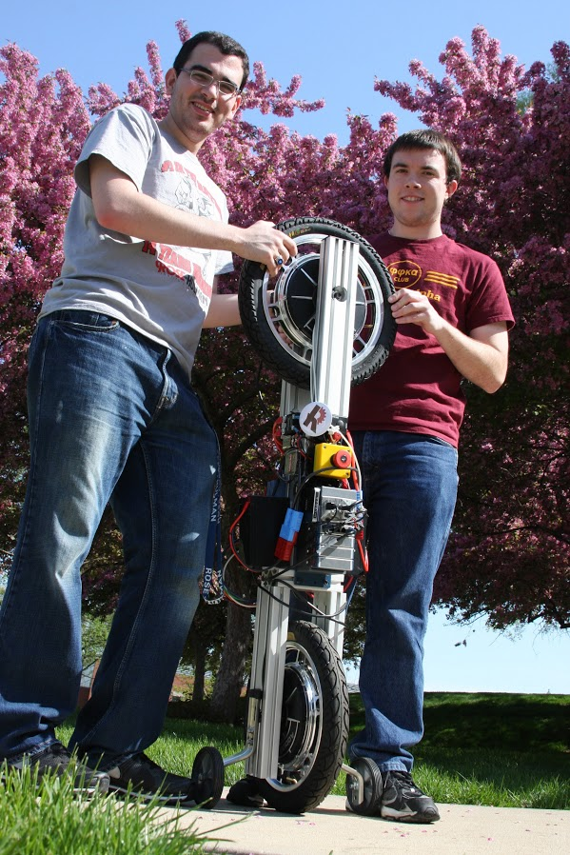
Introduction
Recap
Controls
Code
Testing
Problems
Lessons
Robot
Suggestions
Conclusion
Build a self-balancing robotic unicycle for National Instruments (NI), using NI components where possible
Notes:
Kevin –

Slide 3
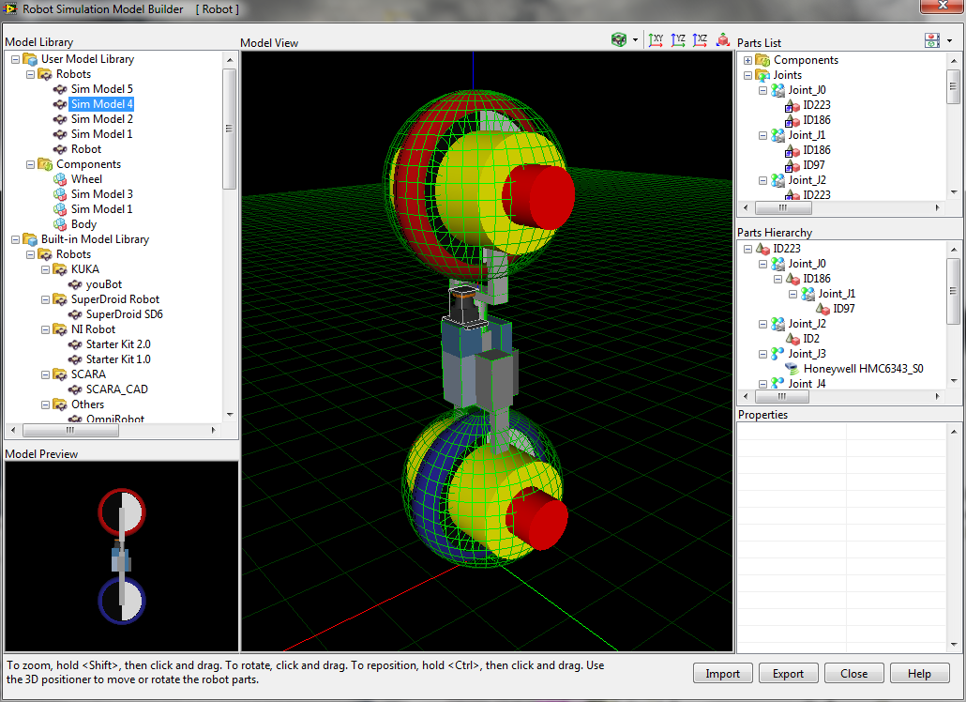
Introduction
Recap of Fall
Controls
Code
Testing
Problems
Lessons
Robot
Suggestions
Conclusion
Notes:
Kevin

Slide 4
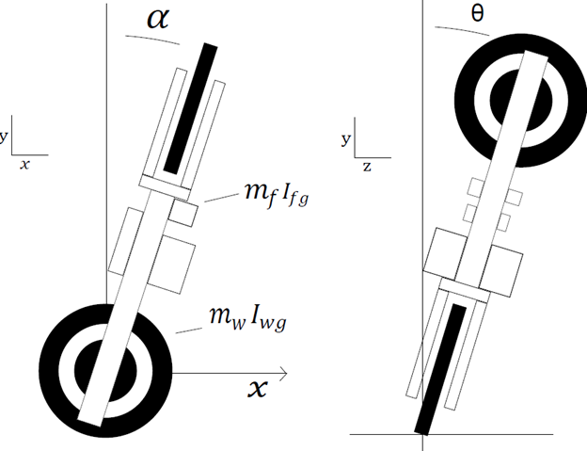
Introduction
Recap of Fall
Controls
Code
Testing
Problems
Lessons
Robot
Suggestions
Conclusion
Notes:
Kevin

Slide 5
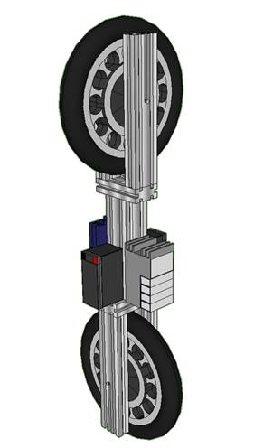
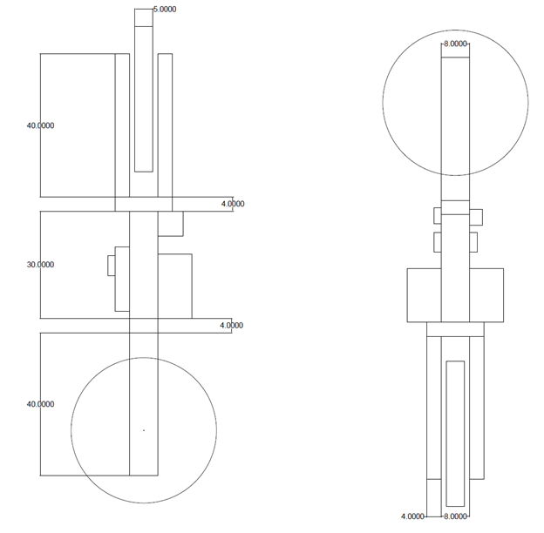
Introduction
Recap of Winter
Controls
Code
Testing
Problems
Lessons
Robot
Suggestions
Conclusion
Build a self-balancing robotic unicycle for National Instruments (NI), using NI components where possible
Notes:
Kevin

Slide 6
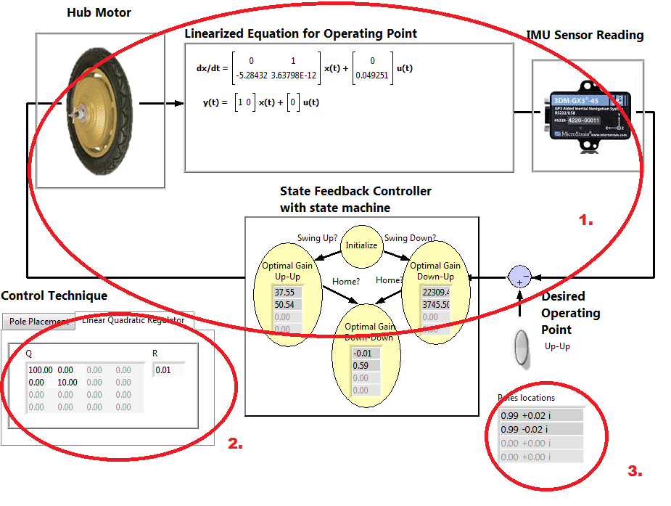
Introduction
Recap
Control System – Closed Loop System Overview
Code
Testing
Problems
Lessons
Robot
Suggestions
Conclusion
This is the closed-loop system controller layout for the entire system. The state feedback controller sets the control efforts which affect the torque being applied to the motors. The changes in torque change the state-space model. Changes detected by the IMU allow the controller to compute new gains.
The user can select the type of controller: Linear Quadratic Regulator or Ackermann pole placement.
The pole locations of the state machine controller are then displayed for user purposes.
Notes:
Ander

Slide 7
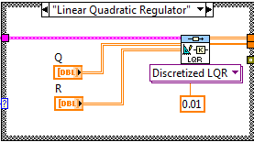
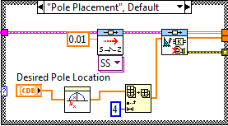
Introduction
Recap
Control System – Controller Approaches
Code
Testing
Problems
Lessons
Robot
Suggestions
Conclusion
Linear Quadratic Regulator
Ackermann Pole Placement
Optimality controller that assigns costs to certain states to prioritize the effort.
An approach that allows us to identify the controllability matrix assuming that the system is controllable
The system must be linearized to assign the costs or weights to the states.
The state-feedback gain matrix can then found after identifying the controllability matrix.
The Q vector is a square MxM matrix where M is the total number of states present in the model.
The user has to preset the desired system poles and pass in a discretized system model.
The R vector is a scalar that multiples to the input of the state-space model.
The controller determines the gains to placed the poles at the desired location
Notes:
Ander

Slide 8
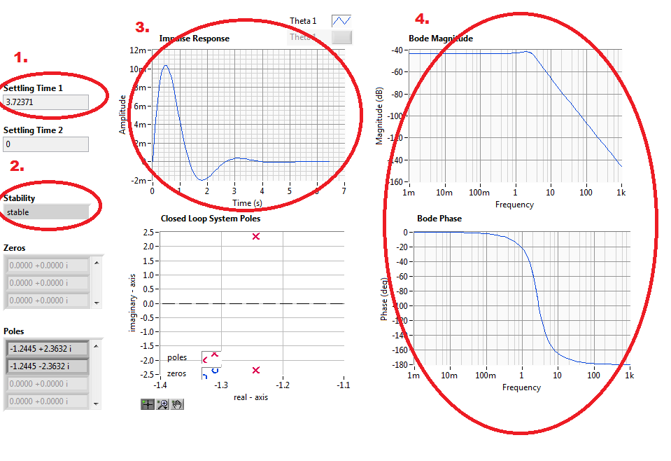
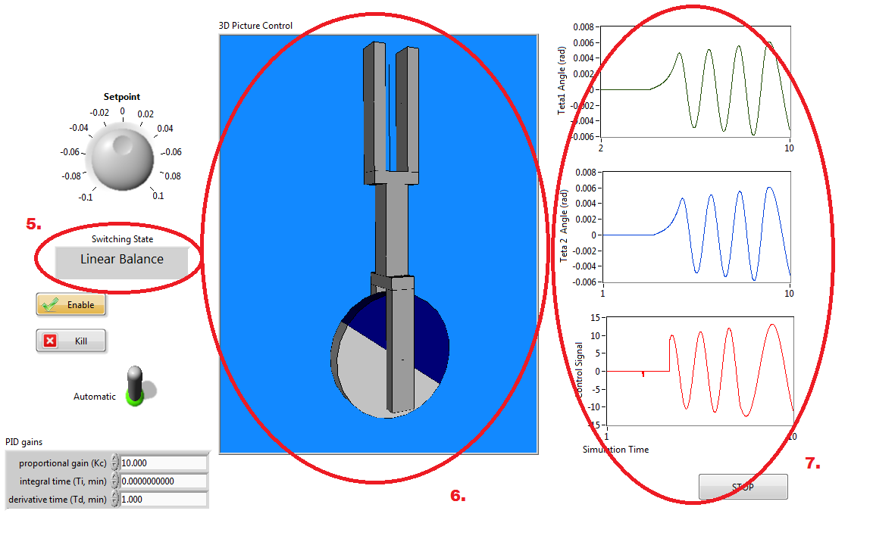
Introduction
Recap
Control System – Analysis in LabVIEW
Code
Testing
Problems
Lessons
Robot
Suggestions
Conclusion
Displays the settling time of a controllable system.
Displays whether the system can reach stability or not.
Displays the impulse response of the controller. This can be used to determined if the system can reach a steady-state response.
The user can see the Bode plots for the calculated system poles of the closed-loop transfer function.
5. The user can see the real-time status of the state machine controller.
6. The system was given a user-friendly visualization for behavioral responses.
7. The user can monitor the status of the states and the control signal that sets the motor speeds and directions.
Notes:
Ander

Slide 9
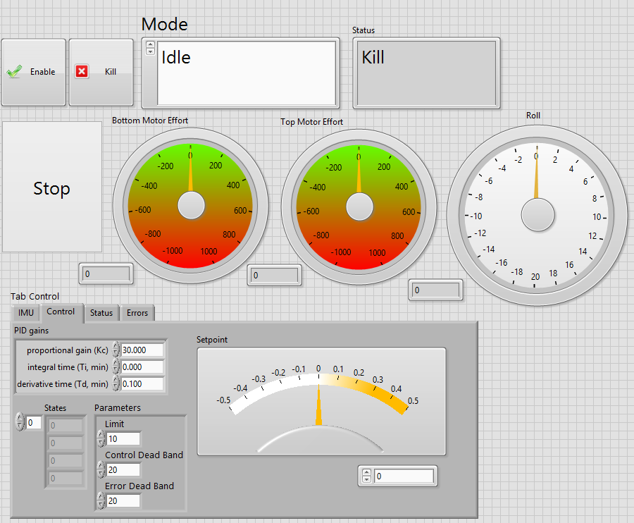
Introduction
Recap
Controls
Code – Front Panel
Testing
Problems
Lessons
Robot
Suggestions
Conclusion
Notes:
Spencer
Laboratory Virtual Instrumentation Engineering Workbench

Slide 10
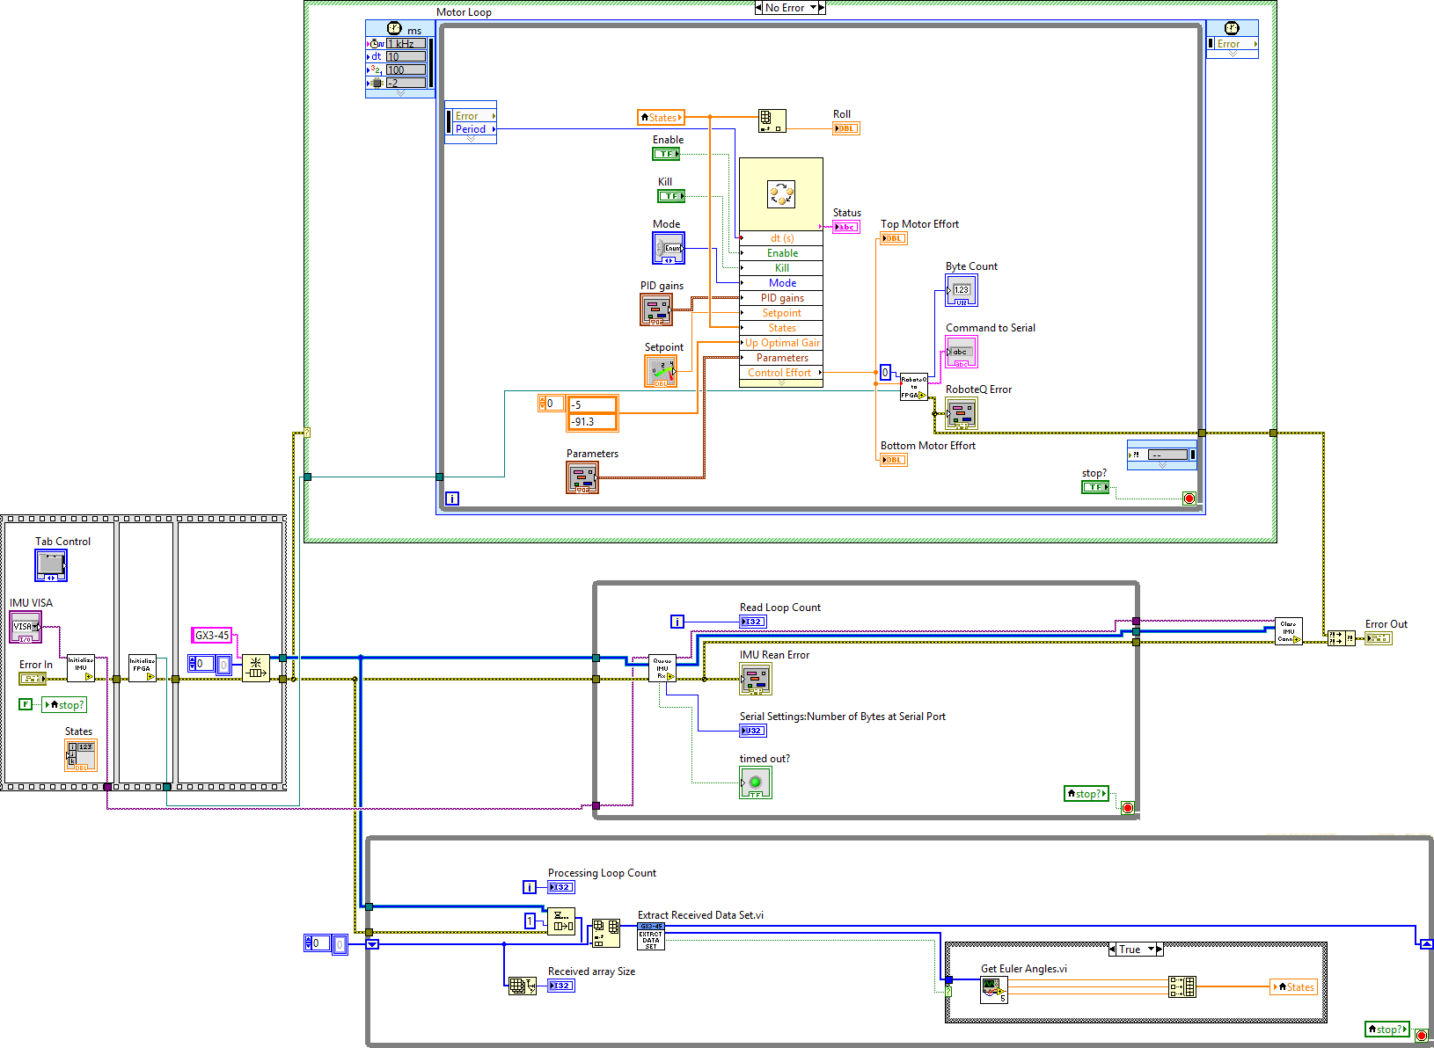
Introduction
Recap
Controls
Code – Block Diagram
Testing
Problems
Lessons
Robot
Suggestions
Conclusion
Notes:
Spencer

Slide 11
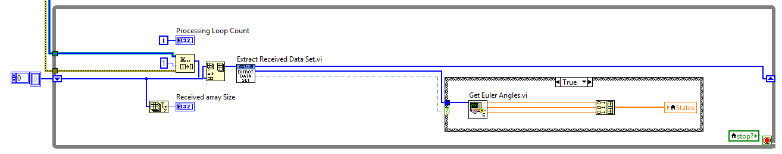
Introduction
Recap
Controls
Code – Data Acquisition Loop
Testing
Problems
Lessons
Robot
Suggestions
Conclusion
1.
2.
3.
The queue of previous IMU readings has a new element added to it in the “Extract Data Set” VI, while the first element is also passed on separately to be analyzed
“Get Euler Angles” VI parses the dataset into roll, pitch, and yaw values
Roll, pitch, and yaw are combined into a three element array, and stored as the States local variable
Notes:
Spencer

Slide 12
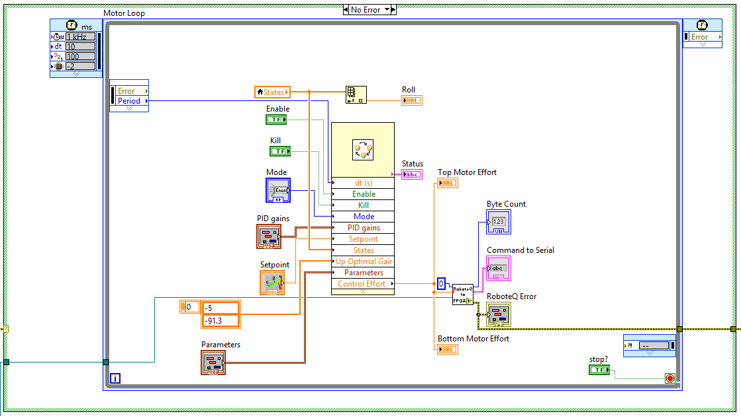
Introduction
Recap
Controls
Code – Control Loop
Testing
Problems
Lessons
Robot
Suggestions
Conclusion
1.
2.
3.
Case structure ensures controls only run if the system has not encountered an error.
Controller sub-VI takes in the state information and any user-set parameters and outputs control efforts and a status state (e.g. running, emergency)
Outputted control efforts are passed to the “FPGA to RoboteQ” sub-VI
Notes:
Spencer

Slide 13
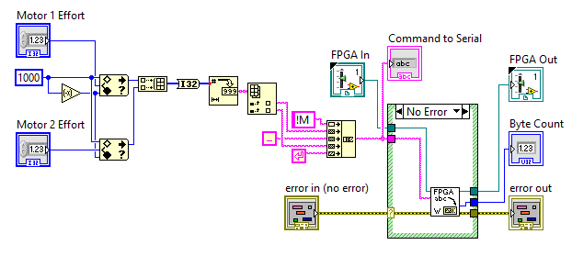
Introduction
Recap
Controls
Code – RoboteQ to FPGA VI
Testing
Problems
Lessons
Robot
Suggestions
Conclusion
1.
2.
3.
4.
Motor Effort values (calculated from control model) are bound by 1000 and -1000.
Effort values are processed from integer values to strings
Strings are combined in the form expected by the motor controllers (!M <1> <2>)
Command is sent to the front panel and to the FPGA write VI (built-in, modified slightly)
Notes:
Spencer

Slide 14
Recap
Controls
Code
Testing Plan – Initial
Problems
Lessons
Robot
Suggestions
Conclusion
Goal | Finished By
Simulation in LabVIEW | November, 2012
Controller Designed | December, 2012
Physical Prototype Constructed | February, 2013
Test 1: Balances in One Dimension (front-back) | March, 2013
Test 2: Balances in One Dimension (side-side) | March, 2013
Test 3: Balances in Two Dimensions | April, 2013
Project Completed | May, 2013
Notes:
Spencer

Slide 15
Recap
Controls
Code
Testing Plan - Progress
Problems
Lessons
Robot
Suggestions
Conclusion
Goal | Percent Complete
Simulation in LabVIEW | 100%
Physical Prototype Constructed | 100%
Controller Designed | 100%
Mathematical Model Designed | 100%
Test 1: Balances in One Dimension (front-back) | 75%
Test 2: Balances in One Dimension (side-side) | 0%
Test 3: Balances in Two Dimensions | 20%
Notes:
Spencer

Slide 16
Controls
Code
Testing
Problems Encountered
Lessons
Robot
Suggestions
Conclusion
Ordering the hub motors – Manufacturer in China was convinced we wanted more than two, and quadruple checked everything was to our satisfaction before shipping (delaying the order by nearly a month)
LabVIEW FPGA – Did not work right away when we received the robot (unable to detect the expansion slots). Several support queries and a few weeks later, a hotfix was provided to us from an obscure forum posting
Modeling – The first model that the team found and our client gave the approval for turned out to be seriously flawed. The team was forced to start over from scratch on the controls for this system
Notes:
Spencer

Slide 17
Code
Testing
Problems
Other Lessons Learned
Robot
Suggestions
Conclusion
Notes:
Ruffin

Slide 18
Testing
Problems
Lessons
Robot
Suggestions
Conclusion
Notes:
Ruffin

Slide 19
Problems
Lessons
Robot
Suggestions for Future Work
Conclusion
Notes:
Ruffin

Slide 20
Lessons
Robot
Suggestions
Conclusion - Questions?
Notes:
Ruffin

